Slide 1


CYBR644 – Cyber Practitioner Lab
Spring 2024
University of Maryland, Baltimore County
Michael Hennick

Slide 2
Overview of the course
Week 01 – Introduction, Ethical Hacking Basics, Ethics, Law
Week 02 – Technical Foundations of Hacking
Week 03 – Reconnaissance, Social Media
Week 04 – Scanning and Probing
Week 05 – Vulnerability Identification
Week 06 – Exploiting Weaknesses
Week 07 – Class Presentations / Review for Exam
Week 08 – Spring Break
Week 09 – Midterm Exam
Week 10 – Privilege Escalation, Maintaining Access
Week 11 – Malware, Covering your Tracks
Week 12 – The Web
Week 13 – Wireless and Mobile Security
Week 14 – Physical Security, Social Engineering, and Security Policies
Week 15 – Class Presentations / Review for Exam
Week 16 – Final Exam
Deadline for All Lab Assignments

Slide 3
REVIEW
- Wireless Technologies
- WiFi (802.11)
- WiFi Attacks
- Mobile Device Issues
- Mobile Device Security
- Apple iOS
- Android OS

Slide 4
Project 2
Two options
Option 1:
Perform research on an information security (cyber security) tool. This could be a deeper dive on the tools we've discussed in class, or you can present on a tool we haven't used/discussed. Whatever tool you choose, please answer the following areas:
1. Background on the tool, such as developer and whether it is "active" as far as being developed and updated.
2. Tool's usage, including a couple use cases on why you would select the tool during a penetration test, or in responding to an incident.
3. Screenshots or demonstration of the tool in use.
4. Comparison of the tool with other's that do similar functions.
Option 2:
Perform a penetration test against all four of the Victim VMs. As you perform the penetration test, be sure to outline the discovery of the systems, what services were found, the vulnerabilities found, and the exploits used. Be sure to also include remediations and recommendations for the vulnerabilities and exploits that you document.
For the report, you can follow a template from Offensive Security (https://www.offensive-security.com/reports/sample-penetration-testing-report.pdf ) or from SANS (https://www.sans.org/reading-room/whitepapers/testing/writing-penetration-testing-report-33343 ), or a combination of the two.

Slide 5
Attack methodology…
6. Hide/Cover Tracks
1. Reconnaissance
5. Gain Foothold
2. Network Discovery
4. Compromise Targets
2. Host/Port Discovery
3. Vulnerability Identification
3.Application Identification

Slide 6
Intrusion Detection Systems
Monitor network traffic
Detect unauthorized access
Notify the administrator or appropriate individuals
Two categories:
Network-based (NIDS)
Host-based (HIDS)
Can also be seen as EDR/XDR agents

Slide 7
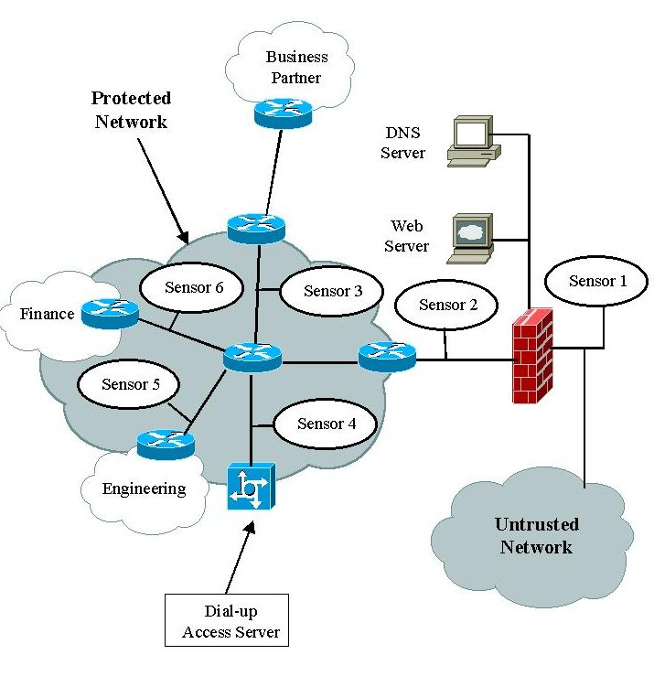
Intrusion Detection Systems cont.
IDS Components:
Network sensors
Central monitoring system
Report analysis
Database and storage
Response box
Sensors placement

Slide 8
Pattern Matching and Anomaly Detection
Anomaly detection system:
Can be configured to use profiles of authorized activity or placed in learning mode
Good at spotting behavior that is different from normal activity
Takes a long time for the system to configure itself and produce fewer false negatives
Protocol decoding systems:
Can reassemble packets and detect abnormal activity
Based on TCP/IP protocol specifications
Must maintain state information
Pattern matching systems:
Rely on database of known attacks.
It triggers an event only if the attack is in the database.

Slide 9
Snort
Freeware IDS developed by Martin Roesch and Brian Caswell
Can work on both Windows and Linux
Operate as a network sniffer and matches activity based on predefined signatures
Snort rules consist of two parts:
Rule header:
Use to identify the rules actions:
Alert
Log
Pass
Activate
Dynamic
Rule options:
Use to identify the rules alert messages.
Not required.

Slide 10
Snort cont.
Common Snort keywords
Keyword | Details
content | Matches a defined payload value
ack | Matches TCP ack settings
flags | Matches TCP flags
id | Matches IP header fragment
ttl | Matched IP header TTL
msg | Prints a message

Slide 11
IDS Evasion
IDS evasion techniques:
Flooding:
The attacker attempts to overload the IDS by flooding it with traffic.
Might also include a number of low-priority IDS triggers to keep the administrator busy.
Evasion:
The IDS discards the packet that is accepted by the host it is addressed to.
Session splicing:
The payload is fragmented and delivered over multiple packets to avoid pattern detection.

Slide 12
IDS Evasion Tools
HTTP Tunneling
ADMutate
Mendax
NIDSbench
Nessus

Slide 13
Firewalls
Hardware or software device designed to limit or filter traffic as it enters and exits the network
NAT:
Translates between private and public IP addresses
Firewall types:
Packet filters:
Configured through access control lists (ACL).
Blocks traffic based on header information.
Each packet is compared to the set of rules as it passes through the router and it is either allowed or denied.
Cannot prevent spoofing.
Cannot inspect the payload of the packet.
Cannot keeps up with state:
Cannot tell if connection started outside or inside the organization

Slide 14
Firewalls cont.
Application and circuit level gateways
Sit between a client and a web server
Reduce traffic and increase security
Stateful inspection:
Keeps track of the status of the connection
Maintains a state table that records the connections
NGFW
Layer 7 visibility/awareness
User visibility/awareness
DMZ:
Protected network that sits between the Internet and the internal network

Slide 15
Identifying Firewalls
Three primary methods:
Port scanning:
One of the most popular
Traceroute with –I option in Linux
Hping
Firewalking:
Firewall discovery tool that crafts packets with a TTL value set to expire one hop past the firewall
Banner grabbing:
FTP, Telnet, and web services are the three main services that send out banners.
No specialized tools are required.

Slide 16
Bypassing Firewalls
Firewall cannot prevent the following attacks:
Insider misuse or internal hacking
Attacks from secondary connections
Social engineering
Physical security
Poor policy or misconfiguration
Trivial FTP could be used to hack firewalls
HTTP Configuration Arbitrary Administrative Access Vulnerability
Trojans

Slide 17
Honeypots
Consists of a single computer configured to appear as if it has valuable information
Set up for the following purposes:
Providing advance warning of a real attack
Tracking the attacker’s activity and keystrokes
Increasing knowledge about attackers’ methodologies
Luring the attackers away from legitimate systems
Honeynet:
Two or more honeypots

Slide 18
Types of Honeypots
Commercial:
KFSensor
NetBait
PatriotBox
Specter
Open Source:
BackOfficer Friendly
LeBrea Tarpit
Honeyd
Tiny Honeypot

Slide 19

Honeypots
OpenBAC
OpenCanary
OsChameleon
PHP-HTTP-Tarpit
Portspoof
PSAD
Pushpin
Recon-ng
RITA
Rubberglue
SET
Simple-Pivot-Detect
Spidertrap
Sqlite Bug Server
Sweeper
TALOS
TcpRooter
Web Bug Server
Weblabyrinth
Wordpot
Gcat
Ghostwriting.sh
HoneyBadger
HoneyBadger Red
Honey Ports
Human.py
Invisiport
Jar-Combiner
Java Applet Web Attack
Kippo
Lockdown
Molehunt
Artillery
Bear Trap
BeEF
Canary Local Demo
Canary Live
Cowrie
Cryptolocked
Cryptolocked-ng
Decloak
DenyHosts
Docz.py
https://adhdproject.github.io

Slide 20
Detecting Honeypots
Attacker can detect the honeypot is not real by probing the services.
Tools:
THC-Amap
Send-safe Honeypot Hunter
Nessus

Slide 21
Functions of Cryptography
The process to conceal the content of a message from everyone except the people that know the key
Encryption: Converting plain text into cipher text
Authentication:
Most common type is username and password.
Integrity:
Information remains unchanged.
Confidentiality:
Information is private while in storage or in transit.
Achieved through encryption.
Nonrepudiation:
Ensures that the sender of data receives proof of delivery and the recipient is assured of the sender’s identity.
Achieved through digital signatures, digital certificates, and message authentication codes.

Slide 22
History of Cryptography
Used throughout the ages by
Spartans.
Ancient Hebrews used a basic cryptographic system called ATBASH.
Julius Caesar:
Caesar cipher
Simple substitution cipher
Items used in cryptosystems:
Algorithm
Plaintext
Ciphertext
Cryptographic key
Substitution cipher
Symmetric encryption
Asymmetric encryption
Encryption

Slide 23
Algorithms
Set of rules used to encrypt and decrypt data.
Used along with the key to encrypt the data.
Plaintext encrypted with a different key or a different algorithm produces different ciphertext.
Modern systems use two types of algorithms:
Symmetric:
Uses the same key to encrypt and decrypt the data
Asymmetric:
Uses different keys for encryption and decryption

Slide 24
Symmetric Encryption
The older of the two forms of encryption
Uses a single shared secret key for encryption and decryption:
Plaintext is encrypted with the key and then transmitted to the recipient who uses the same key to decrypt it.
Fast and hard to break if a large key is used.
Disadvantages:
Key distribution
Does not provide authentication, only confidentiality
Symmetric algorithms:
DES
Blowfish
Rijndael
RC4
RC5
SAFER

Slide 25
Data Encryption Standard (DES)
Developed by National Bureau of Standards (NBS) – now NIST.
Based on Lucifer algorithm developed by IBM but modified to use 56-bit key.
Must be recertified every 5 years.
By 1993 outlived its usefulness, and NIST began to look for new algorithm to replace it.
In 1998 the Electronic Frontier Foundation (EFF) cracked it in 23 hours.

Slide 26
Data Encryption Standard (DES) cont.
Functions as a block cipher.
Segments the input data into blocks.
Processes 64-bit plaintext at a time, outputs 64 bits of ciphertext, and works as a substitution cipher.
Uses 56-bit key; the remaining bits are used for parity.
Uses the same key to encrypt and decrypt the data.
Performs 16 rounds on every 64-bit block.
Has four modes or types, each with a different strength:
Electronic Codebook mode (ECB)
Cipher Block Changing mode (CBC)
Cipher Feedback mode (CFB)
Output Feedback mode (OFB)
3DES was implemented to extend the usefulness of DES:
Uses two or three keys; each key is 168 bit

Slide 27
AdvanceD Encryption Standard (AES ) and Rivest Cipher (RC)
In 2002 NIST replaced DES with Rijndael:
Iterated block cipher supporting variable keys and block lengths of 128, 192, or 256 bit
Considered fast and simple and uses a four-step, parallel series of rounds
AES is the US Federal Standard (FIPS-197)
Rivest cipher (RC):
General term for family of ciphers designed by Ron Rivest
RC2: Variable key size and 64-bit block cipher
RC4: Stream cipher
RC5: Block cipher with rounds ranging from 0 to 255 and keys from 0 to 2,040 bits
RC6: Variable key size and rounds

Slide 28
Asymmetric Encryption (Public Key Encryption)
Requires two keys:
Public key: Given to anyone
Private key: Kept a secret
Uses difficult mathematical problems: Trapdoor function
RSA:
Developed in 1977 at MIT
Uses two large prime numbers and works on the principle of factoring them
Used for encryption and digital signatures
Used by Internet Explorer and Firefox
Diffie-Hellman:
Developed for use as a key exchange protocol
Used in SSL and IPsec
Vulnerable to main-in-the-middle attack
El Gamal:
Used for encryption and digital signatures
Based on the difficulty of solving discrete logarithm problems
Elliptic Curve Cryptosystem (ECC):
Requires less processing power: Used in PDAs and cell phones

Slide 29
Hashing
Takes a variable amount of data and uses an algorithm to produce a fixed length hash value
Used to provide integrity
Collision:
When two or more different files produce the same hash value
MD5:
Produces 128-bit hash value
SHA-1
Produces 160- bit message digest

Slide 30
Digital Watermark
Commercial application of steganography.
Acts as a type of digital fingerprint and can be used to verify the owner of the work.
Could be used in cases of intellectual property theft to show proof of ownership.
Adobe Photoshop includes capability to add watermarks.

Slide 31
Digital Signatures
The application of asymmetric encryption for authentication
Similar to a real signature
Validates the integrity of the document and identity of the sender

Slide 32
Digital Certificates
Used to prove the identity of the owner.
Similar to a passport .
Issued by certificate authority:
VeriSign
Entrust
Thawte
Contain the following information:
Identification information such as username, serial number, and the validity dates of the certificate
The public key of the certificate folder
The digital signature of the signature authority
X.509 is the standard for digital certificates.

Slide 33
Public Key Infrastructure (PKI)
Framework that consists of hardware, software, and policies used to manage, create, store, and distribute keys and digital certificates
Components:
The Certificate Authority (CA)
The Certificate Revocation List (CRL)
The Registration Authority (RA)
Certificate Server
X.509 Standard

Slide 34
Trust Models
Single Authority trust:
Uses a single third-party central agency.
The agency provides the trust, the authority, and any keys issued by that authority.
Hierarchical trust:
The top layer of trust is the root CA.
Root CA issues certificates to intermediate CAs.
Intermediate CAs issue certificates to leaf CAs.
Leaf CAs issue certificates to user.
Web of trust:
Consists of many supporters that sign each other’s certificates.
PGP uses the web of trust model.

Slide 35
Protocols, Standards, and Applications
Secure MIME (S/MIME):
Supports X.509 digital certificates and RSA encryption
Pretty Good Privacy (PGP):
Similar to PKI but does not have a CA.
Builds a web of trust.
Users sign and issue their own keys.
Secure Shell (SSH):
Permits secure remote access over a network
Secure Socket Layer (SSL):
Provides security and privacy on the Internet
Uses RSA public key cryptography
IPsec:
Can be used in tunnel and transport mode
Point-to-point tunneling protocol (PPTP):
Widely used in VPNs
Encrypted File System (EFS):
Developed by Microsoft to encrypt NTFS files and folders
Bitlocker
Works with Trusted Platform Model to encrypt hard or removable drives

Slide 36
Encryption Cracking Tools
Crtptanalysis
CryptoBench
JCryptTool
AlphaPeeler
Ganzua
Crank
EverCrack
Passcracking
Distributed Network Attack (DNA)
John the Ripper
Command Line Scripter
CryptoHeaven

Slide 37
Weak Encryption
Weak (aka NOT) encryption methods:
XOR
Base64
Uuencode

Slide 38
Steganography
Hiding information in plain sight.
Messages can be hidden in images, sound files, other files, and white space.
The file in which the data is hidden is called a carrier.
The actual amount of information hidden depends on the size of the carrier file.
Steganography programs can also use encryption when hiding the message.

Slide 39
Steganography Tools
Tools hiding messages in documents
Snow
Tools hiding messages in sound files
Steghide
MP3Stego
Tools hiding messages in pictures
S-Tools
ImageHide
OutGuess
WbStego
JP Hide and Seek
Steganalysis
Discovering and extracting steganography content

Slide 40

Break

Slide 41
Threats to Physical Security
Can be caused by natural events, man-made events, utility loss, or equipment failure
Natural events:
Floods
Fire
Hurricanes and tropical storms
Tidal waves
Earthquakes
Other natural events

Slide 42
Threats to Physical Security cont.
Man-made threats:
Theft
Vandalism
Destruction
Equipment failure:
Mean Time Between Failure (MTBF)
Mean Time to Repair (MTTR)
Loss of utility

Slide 43
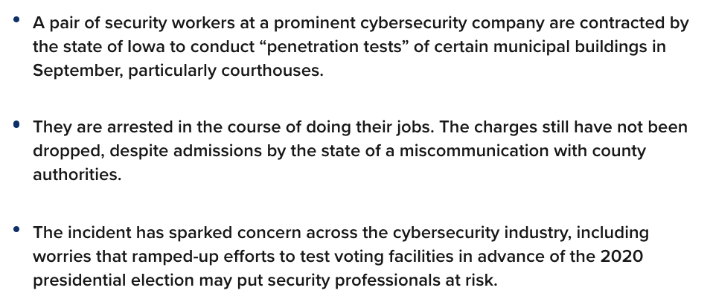
Threats to Physical Security cont.
https://www.cnbc.com/2019/11/12/iowa-paid-coalfire-to-pen-test-courthouse-then-arrested-employees.html

Slide 44
Equipment Controls
Locks
Mechanical
Warded locks
Tumbler locks
Keypad and combination locks
Basic combination lock
Programmable cipher lock
Master key locks
Device locks
Ace locks
Lock grades
Grade 1 – provides highest security
Grade 2
Grade 3 – weakest design

Slide 45
Equipment Controls
Lock bypassing techniques
Bump keys
Lock picking
Shimmming
Fax Machines
Must be placed in secure location.
If the fax machine uses ribbons or roll refills, those need to be shredded.

Slide 46
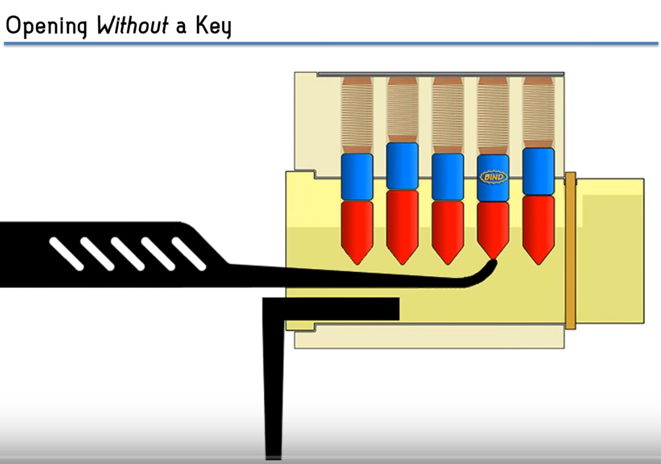
Who needs keys?
https://www.youtube.com/watch?v=raBMFqZRB0s&feature=youtu.be

Slide 47
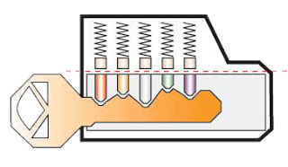
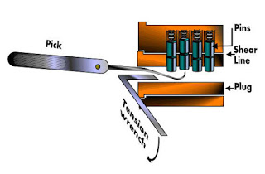
Lock Picking/Shimming
How To make your own lock shim
https://www.youtube.com/watch?v=ipMi6ryESqk

Slide 48
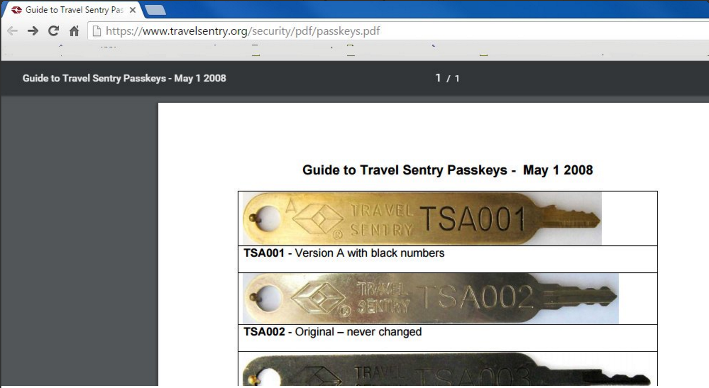
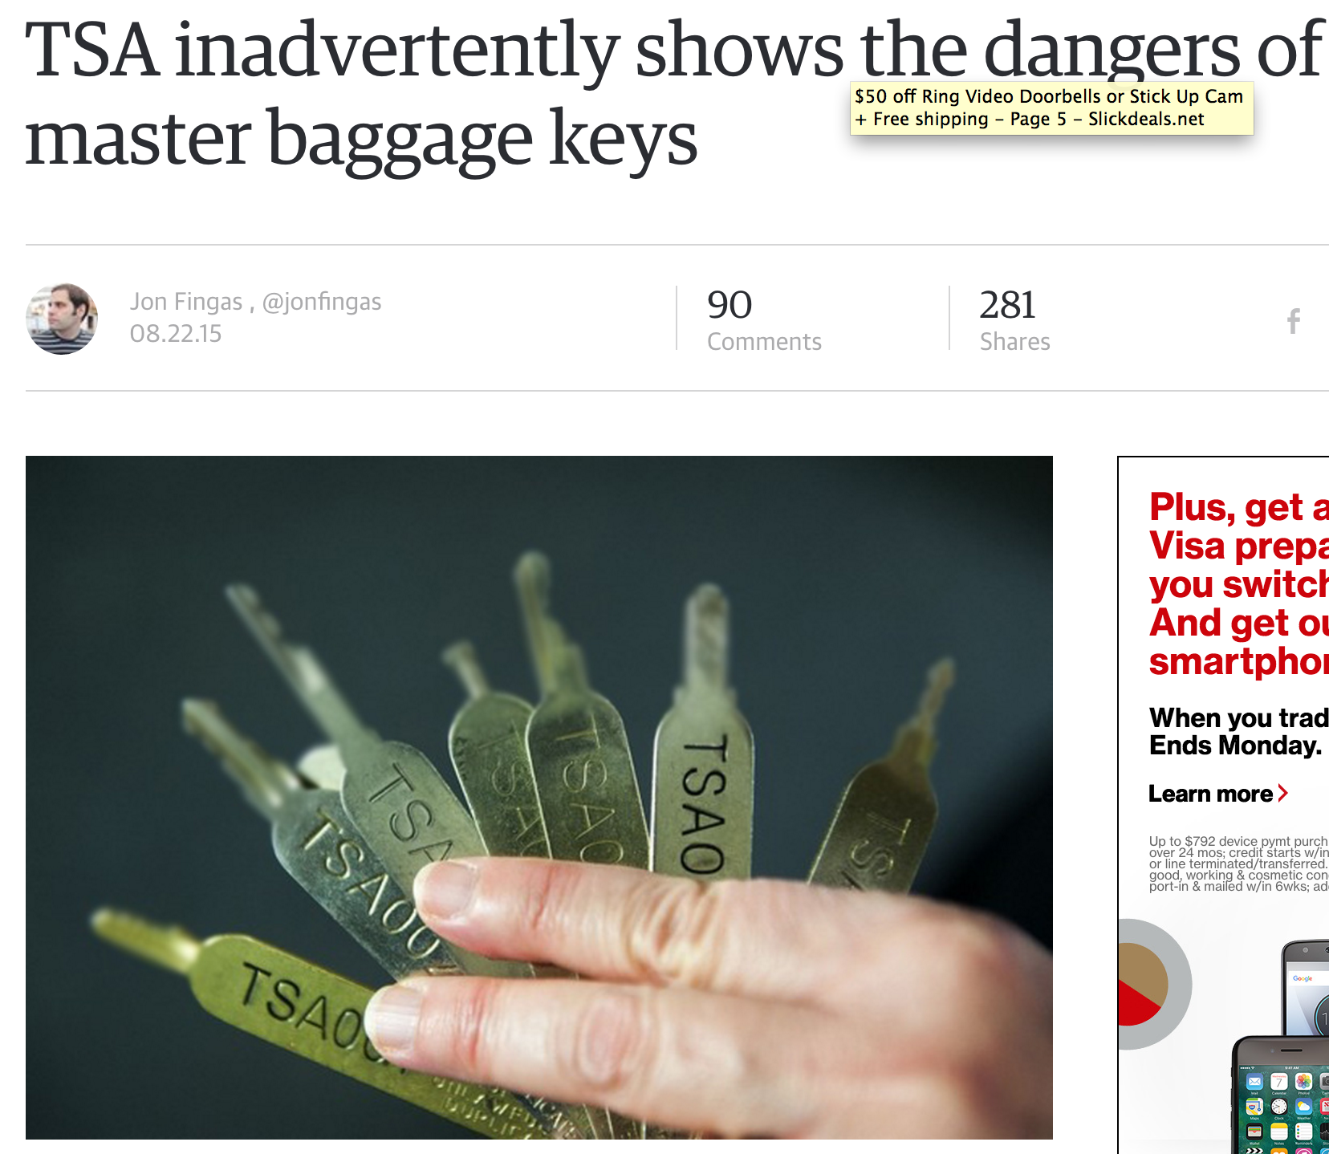
Lock picking concerns
https://xi.hope.net/schedule.html#-the-tsa-keys-leak-government-backdoors-and-the-dangers-of-security-theater-
https://www.engadget.com/2015/08/22/tsa-reveals-master-baggage-keys/

Slide 49
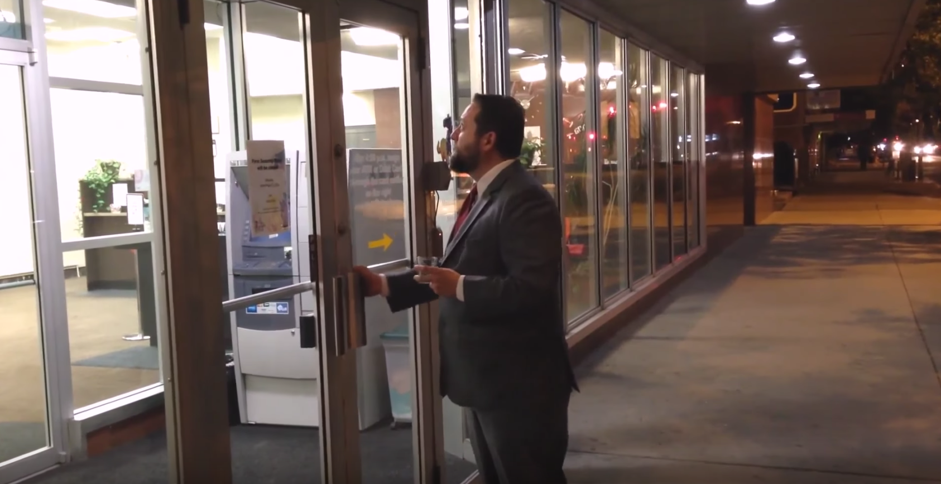
Who needs keys?
https://www.youtube.com/watch?v=SDl4AO4ancI

Slide 50
Area Controls
Solid doors for server rooms
True floor-to-ceiling walls
Windows
Closed-circuit TV cameras

Slide 51
Location Data and Geotagging
Location data is typically collected in latitudes and longitudes
Location data can be collected by
Geotagging
Smartphone triangulation

Slide 52
Location Data and Geotagging
https://www.engadget.com/2019/08/09/3fun-dating-app-exposes-users-data/
https://www.pentestpartners.com/security-blog/group-sex-app-leaks-locations-pictures-and-other-personal-details-identifies-users-in-white-house-and-supreme-court/

Slide 53
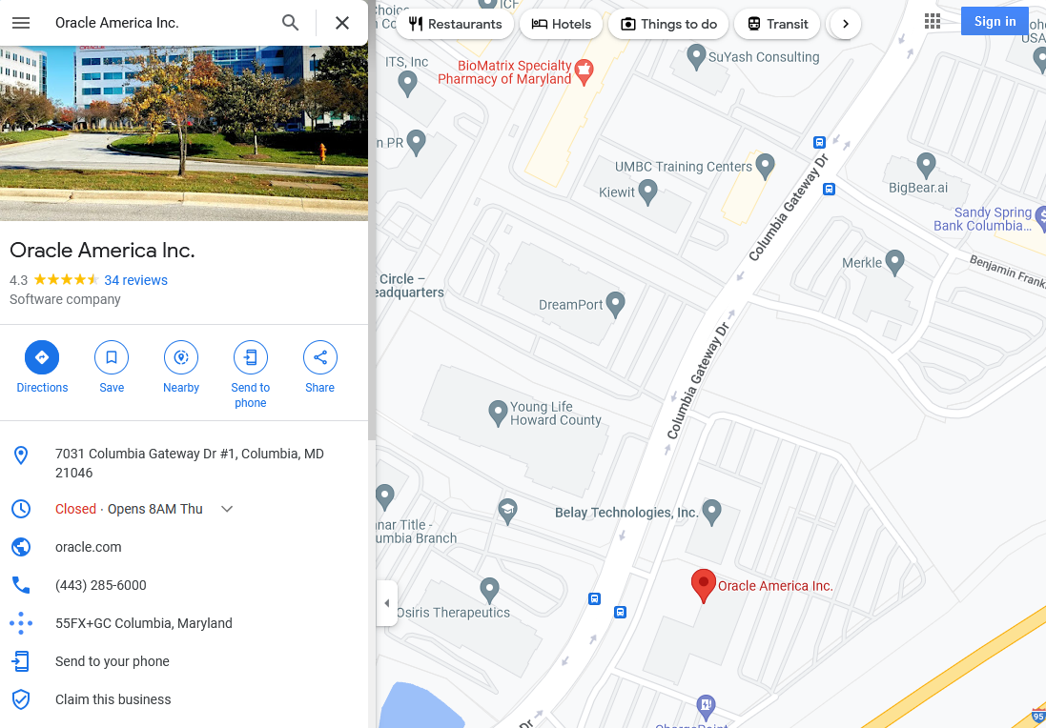
Location Data and Geotagging

Slide 54
Facility Controls
Fences
Lights
Guards
Dogs
Gates
Locks
Bollards
Turnstile
Mantraps

Slide 55
Personal Safety Controls
Fire prevention and detection systems:
Heat activated
Smoke activated
Fire suppression systems:
Class A – Paper or wood – Water, Soda Acid
Class B – Gasoline or oil – CO2, Soda Acid, Halon
Class C - Electronic or computer – CO2, Halon
Class D – Combustible Metals – dry powder

Slide 56
Physical Access Control
Authentication:
Passwords and pin numbers – something you know
Tokens, smart cards, and magnetic strip cards – something you have
Biometrics – something you are:
Considered a strong form of authentication
Fingerprints
Facial scans
Hand geometry
Palm scan
Retina pattern
Iris recognition
Voice recognition

Slide 57
Social Engineering
Tricking someone into providing information or giving something they should not
Types of social engineering:
Scarcity
Authority
Liking
Consistency
Social validation
Reciprocation

Slide 58
Person-to-Person-Based Social Engineering
Works on a personal level by using one of the following techniques
Important user
Third–party authorization
Masquerading
In person

Slide 59
Computer-Based and Reverse Social Engineering
Uses software to retrieve information:
Pop-up windows
Email attachments
Smartphone
Social networking
Websites
Reverse social engineering:
Sabotaging someone else’s equipment and offering to fix the problem

Slide 60
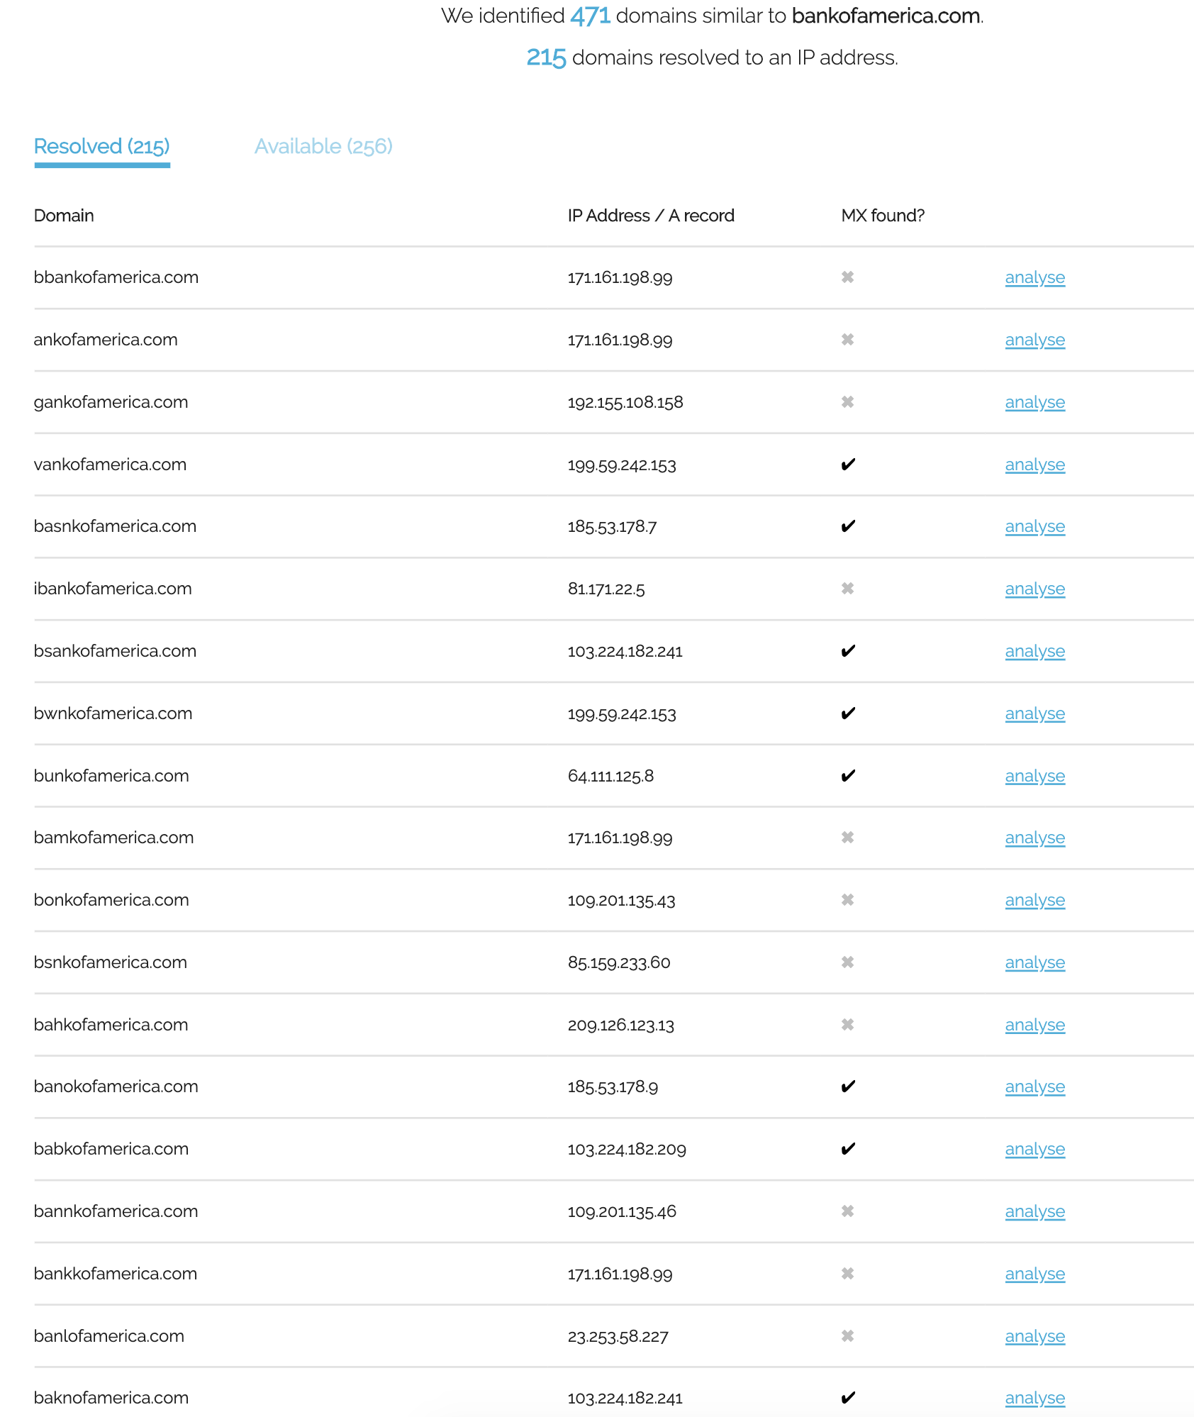
Social Engineering
https://dnstwister.report/

Slide 61

Social Engineering
Spot the difference?

Slide 62
Social Engineering
What if you could register a domain that “looked” like the legitimate domain, in a different character set?
Homoglyphs
Punycode
https://www.cyberscoop.com/homoglyph-zero-day-verisign-soluble/

Slide 63

Social Engineering
https://www.punycoder.com/
🐉 🐉 🐉.ws
💩 💩 💩 💩 💩.ws
ʟairɴet.com

Slide 64
Governmental and Commercial Data Classification
Governmental information classification systems:
Unclassified
Confidential
Secret
Top secret
Commercial information classification system:
Public
Sensitive
Private
Confidential

Slide 65
Policies and Procedures
Employee Hiring and Termination policies
Help Desk Procedures and Password Change policies
Employee identification
Privacy policies
Network & Endpoint monitoring policies
Personal device policies
Teleworker policies
Cloud/third party services policies

Slide 66
Threat Emulation/Red Teaming
Diamond Model
http://www.activeresponse.org/the-diamond-model/

Slide 67
Threat Emulation/Red Teaming
Cyber Kill Chain
https://www.lockheedmartin.com/en-us/capabilities/cyber/cyber-kill-chain.html

Slide 68
Threat Emulation/Red Teaming
Unified Kill Chain
https://www.csacademy.nl/en/csa-theses/february-2018/104-the-unified-kill-chain

Slide 69
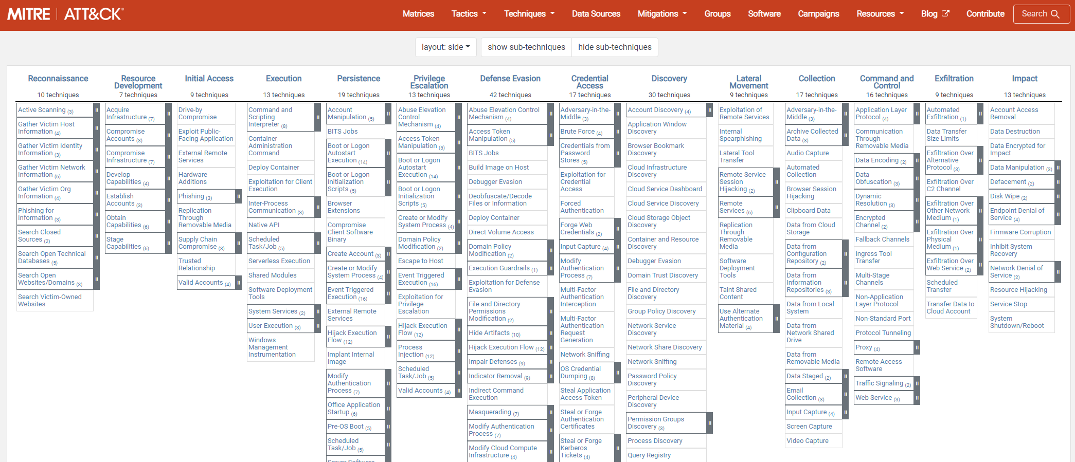
Threat Emulation/Red Teaming
https://attack.mitre.org/
https://mitre-attack.github.io/caret/#/

Slide 70
Threat Emulation/red teaming

Slide 71
Purple teaming
Offense
Vulnerability Assessments
Penetration Tests
Social Engineering
Defense
Implementing Controls
Security Monitoring
Incident Response
Common Goal
Improve organization security posture

Slide 72
Penetration Testing Reporting
Document your attack
Include scope definition
Document your methods
Qualify your findings
Critical/High/Medium/Low/Info
Document remediations or recommendations
https://www.offensive-security.com/reports/sample-penetration-testing-report.pdf
http://www.niiconsulting.com/services/security-assessment/NII_Sample_PT_Report.pdf
http://www.pentest-standard.org/index.php/Main_Page

Slide 73
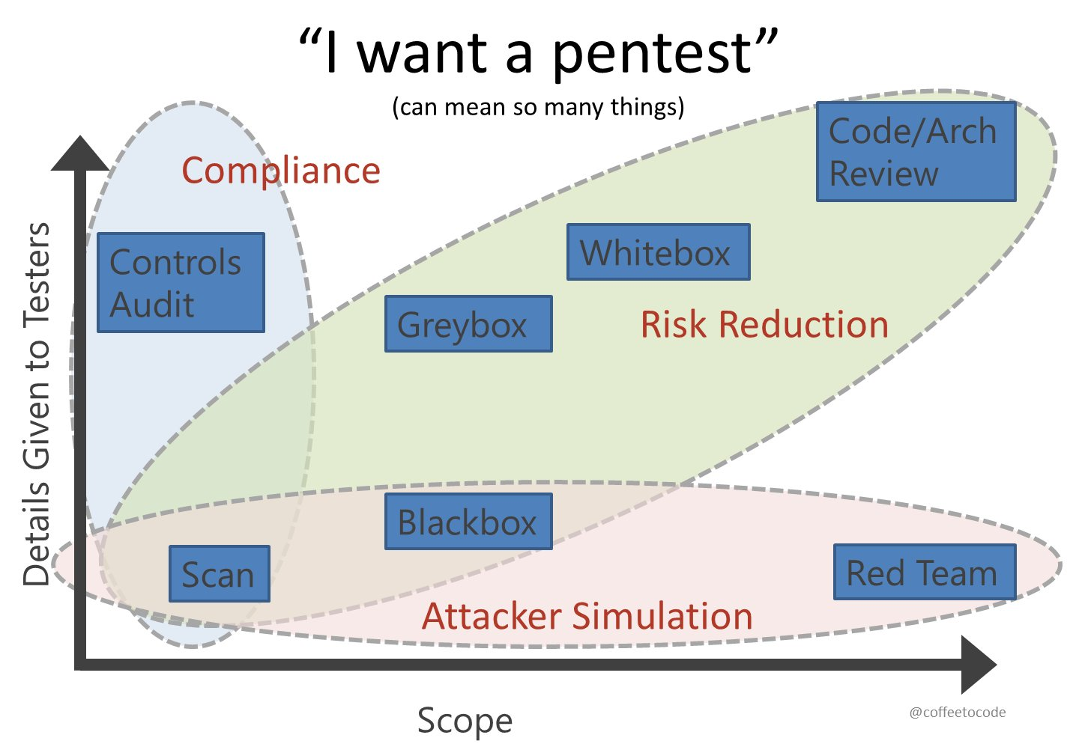
Course conclusion

Slide 74
Perspectives
Attacker Perspective
1. Understand defensive technologies a target may be using to better craft your attack
2. Test your attacks in a lab using defensive technologies
3. Identify physical weaknesses in your target that will enable you to execute a technical attack

Slide 75
Perspectives
Defender Perspective
1. Understand defensive technologies and determine what capabilities are currently missing from your defensive arsenal
2. Understand physical security weaknesses that are often overlooked, which can then be used to launch other attacks against your organization

Slide 76
Perspectives
Investigator Perspective
1. Understand defensive technologies which can assist in an investigation
2. Understand both the technical/cyber realm and physical world when performing incident response investigations

Slide 77
Summary
IDS, Firewalls, Honeypots
Explain IDS and their types and components.
Describe pattern matching and anomaly detection.
Identify IDS evasion techniques and tools.
Know different types of firewalls, describe honeypots.
Be familiar with NAT, Proxy, and DMZ.
Cryptography
Define cryptography and know how it works.
Symmetric and Asymmetric encryption.
Digital signatures/digital certificates, hashing.
PKI.
Encryption protocols.
Crypto attacks, encryption cracking tools.

Slide 78
Summary
Physical Security
Threats to physical security.
Biometric devices
Types of access control.
Social engineering attacks.
Policies and procedures.

Slide 79
Lab

